Slide 1
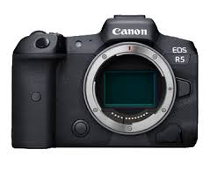
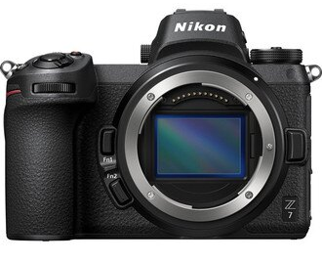
Lexar CFexpress Card Compatible Cameras
Title Here
Camera Brand | Model | Lexar CFe Compatibility
Canon | EOS R5 | Yes
 | EOS-1D X Mark III | Yes
 | EOS C500 Mark III | Yes
 | EOS C300 Mark II | Yes
Panasonic | S1 | Update FW 1.5 or higher
 | S1R | Update FW 1.5 or higher
Nikon | Z7 | Update FW 3.0 or higher
 | Z6 | Update FW 3.0 or higher
 | D6 | Yes
 | D5 / D850 / D500 | Camera FW not released
2020.09.08 update

Slide 2
Lexar CFexpress Cards confirmed
Related Official website
Panasonic：
S1/S1R 128GB&256GB
https://av.jpn.support.panasonic.com/support/dsc/connect/cfe/
https://av.jpn.support.panasonic.com/support/global/cs/dsc/connect/cfe/
Nikon：
Z6/Z7 128GB&256GB
https://www.nikonusa.com/en/nikon-products/mirrorless-cameras/firmware-updates/index.page
Canon:
R5 128GB&256GB
https://faq.canon.jp/app/answers/detail/a_id/101696/~/%E3%80%90%E3%83%9F%E3%83%A9%E3%83%BC%E3%83%AC%E3%82%B9%E3%82%AB%E3%83%A1%E3%83%A9%E3%80%91eos-r5-%E4%BD%BF%E7%94%A8%E5%8F%AF%E8%83%BD%E3%81%AA%E3%83%A1%E3%83%A2%E3%83%AA%E3%83%BC%E3%82%AB%E3%83%BC%E3%83%89%E3%81%AF%EF%BC%9F
EOS-1D X Mark III 128GB&256GB
https://faq.canon.jp/app/answers/detail/a_id/101122/~/%E3%80%90%E3%83%87%E3%82%B8%E3%82%BF%E3%83%AB%E4%B8%80%E7%9C%BC%E3%83%AC%E3%83%95%E3%82%AB%E3%83%A1%E3%83%A9%E3%80%91eos-1d-x-mark-iii-%E4%BD%BF%E7%94%A8%E5%8F%AF%E8%83%BD%E3%81%AA%E3%83%A1%E3%83%A2%E3%83%AA%E3%83%BC%E3%82%AB%E3%83%BC%E3%83%89%E3%81%AF%EF%BC%9F
*Indicated FW version needed on camera
Confidential

Slide 3
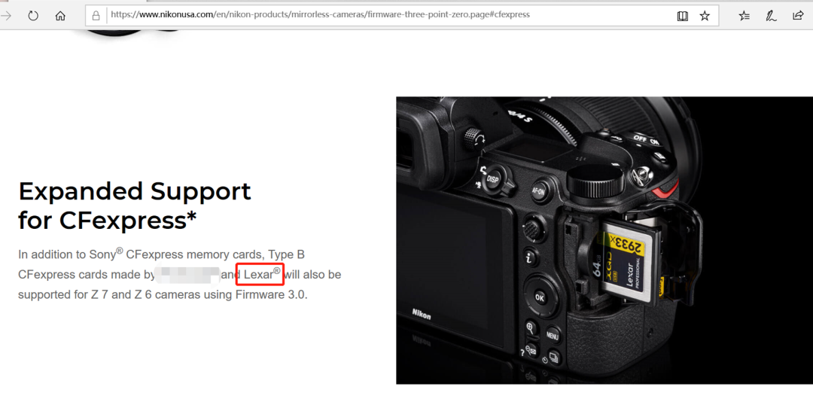
Lexar CFexpress Cards confirmed
<Screenshot from Nikon official website>
*Indicated FW version needed on camera
Confidential

Slide 4
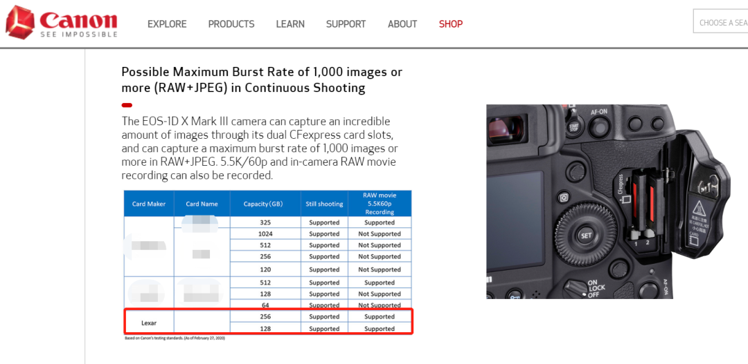
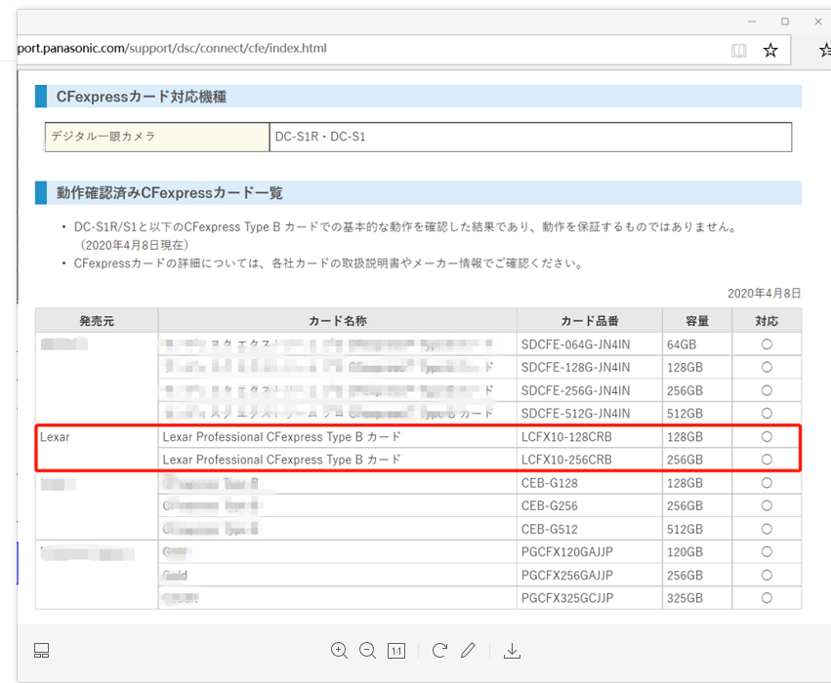
Lexar CFexpress Cards confirmed
<Screenshot from Canon official website>
<Screenshot from Panasonic official website>
*Indicated FW version needed on camera
Confidential

